Slide 1
Horizontal Directional Drilling

Slide 2
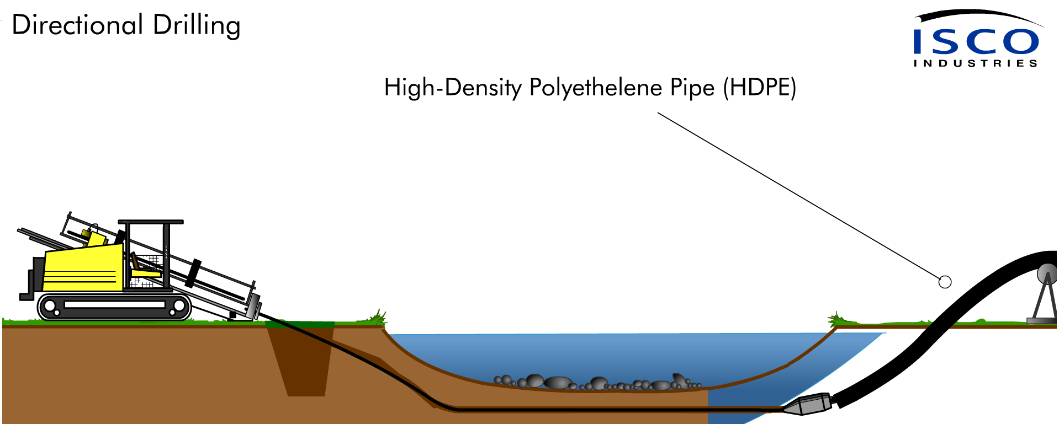

HDPE in Directional Drilling Applications

Slide 3
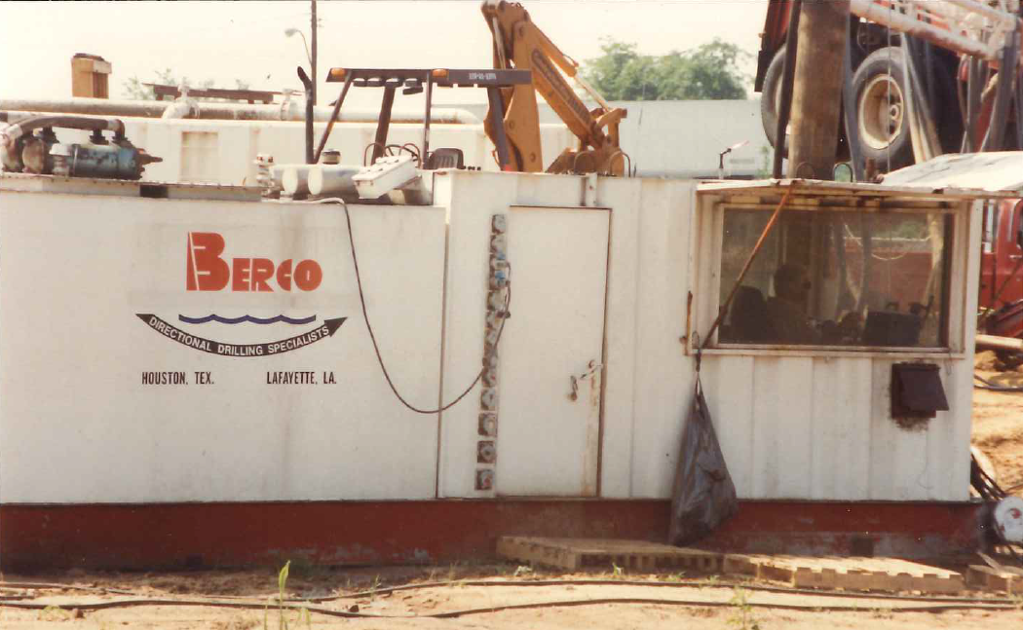
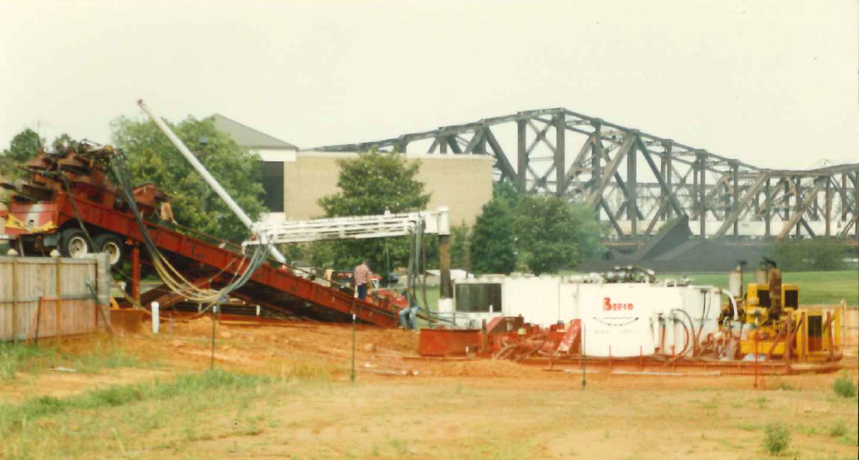
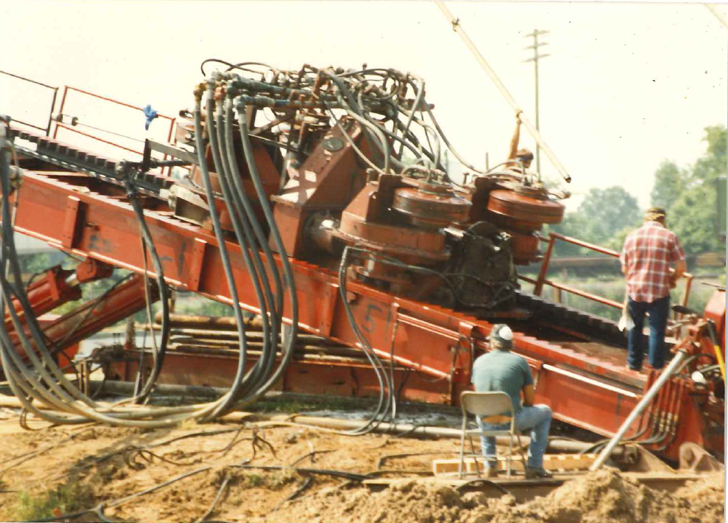
Mississippi River Bore 1992
3,600 ft 8” Black Iron Pipe w/ 7 Innerducts
AT&T Fiber Communications

Slide 4
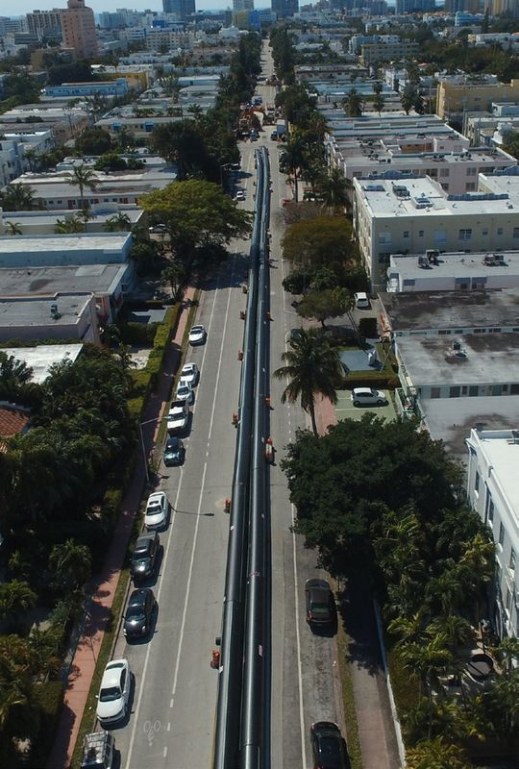


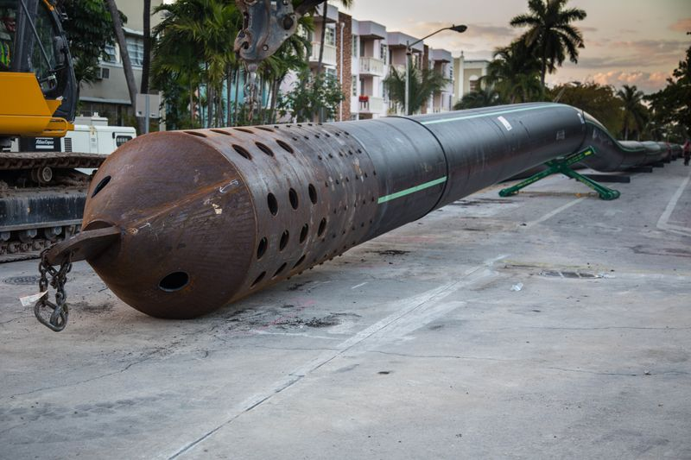
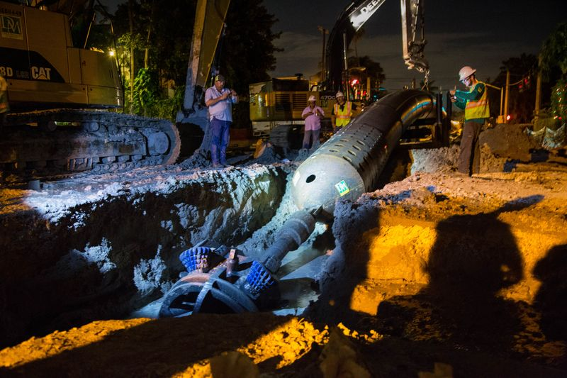
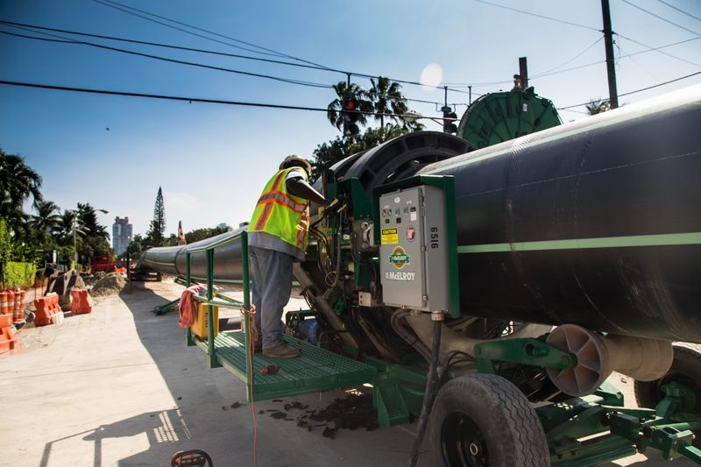

Miami Beach HDD Installation 4,200 ft of 54” HDPE Installed

Slide 5
Outline
Industry guidelines for use and evaluation of HDPE in HDD applications
Joining of HDPE & Connection of bore string to main pipeline
Material properties and design considerations for HDD installation
Planning, Design and Mitigation of Risks
Case Studies and Reference Literature / Links
Summary & Questions

Slide 6
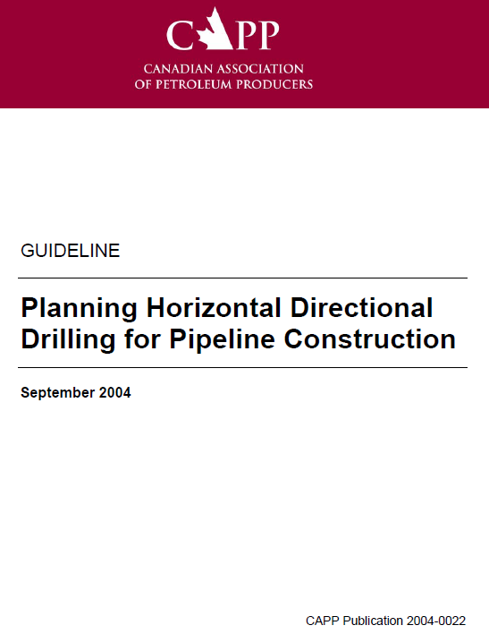
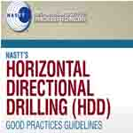

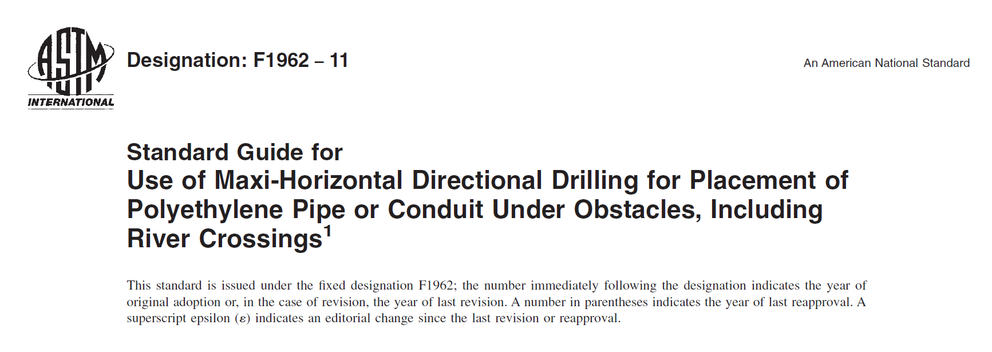
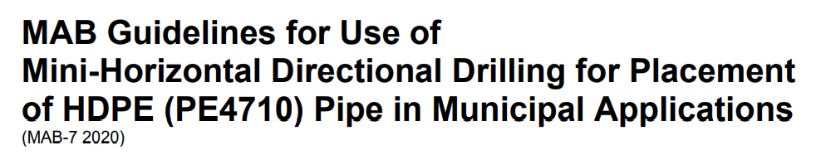
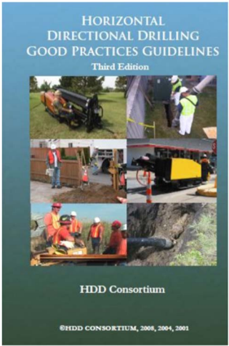

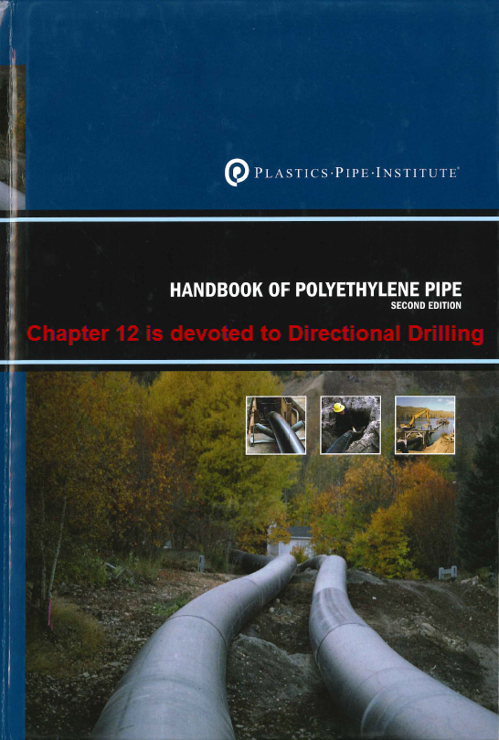
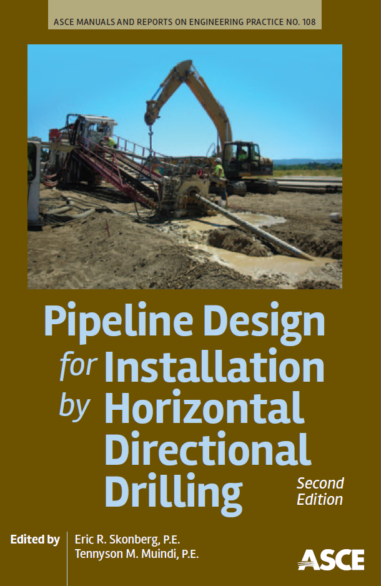
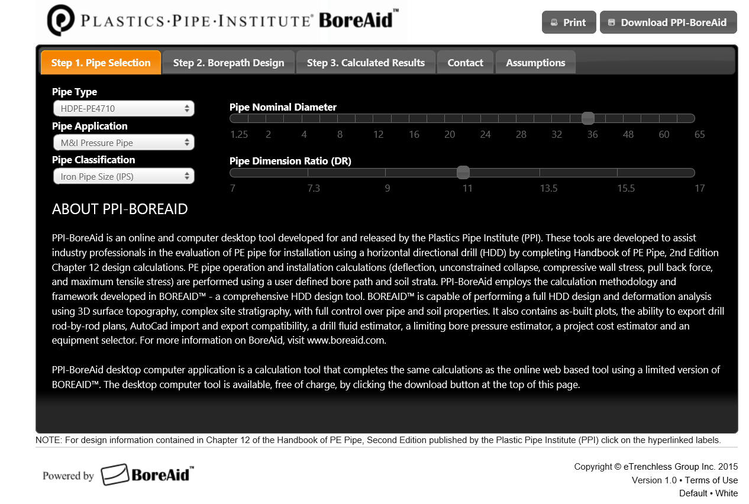

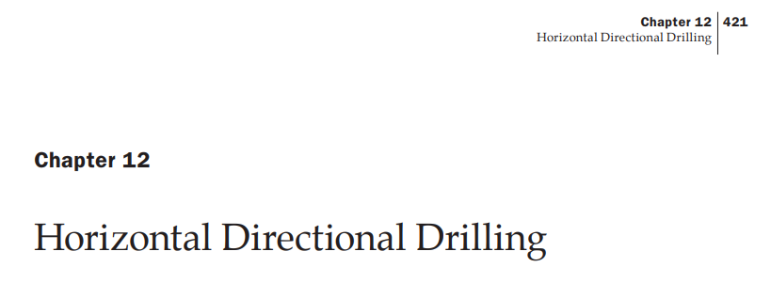
Industry Guidelines

Slide 7
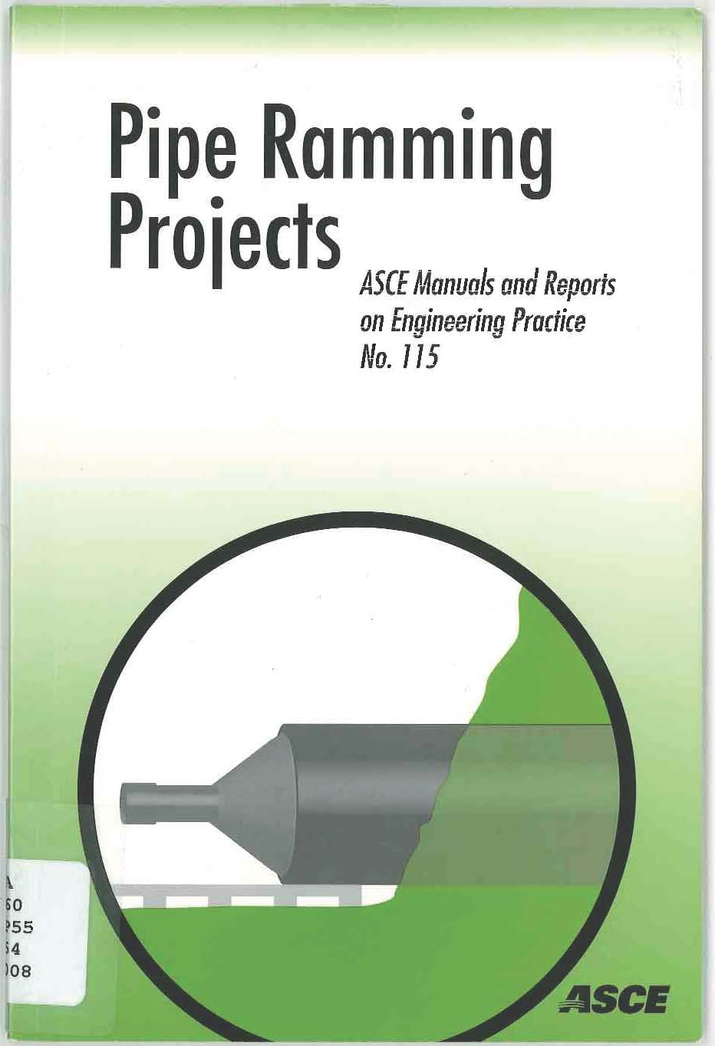
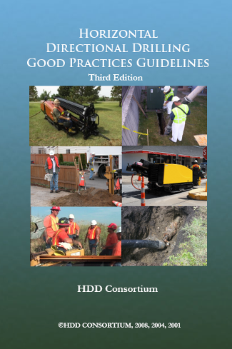
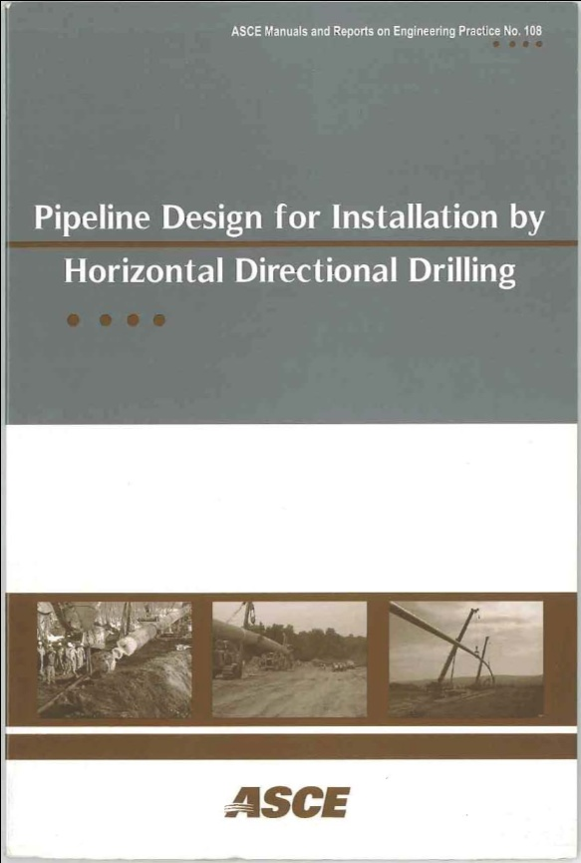

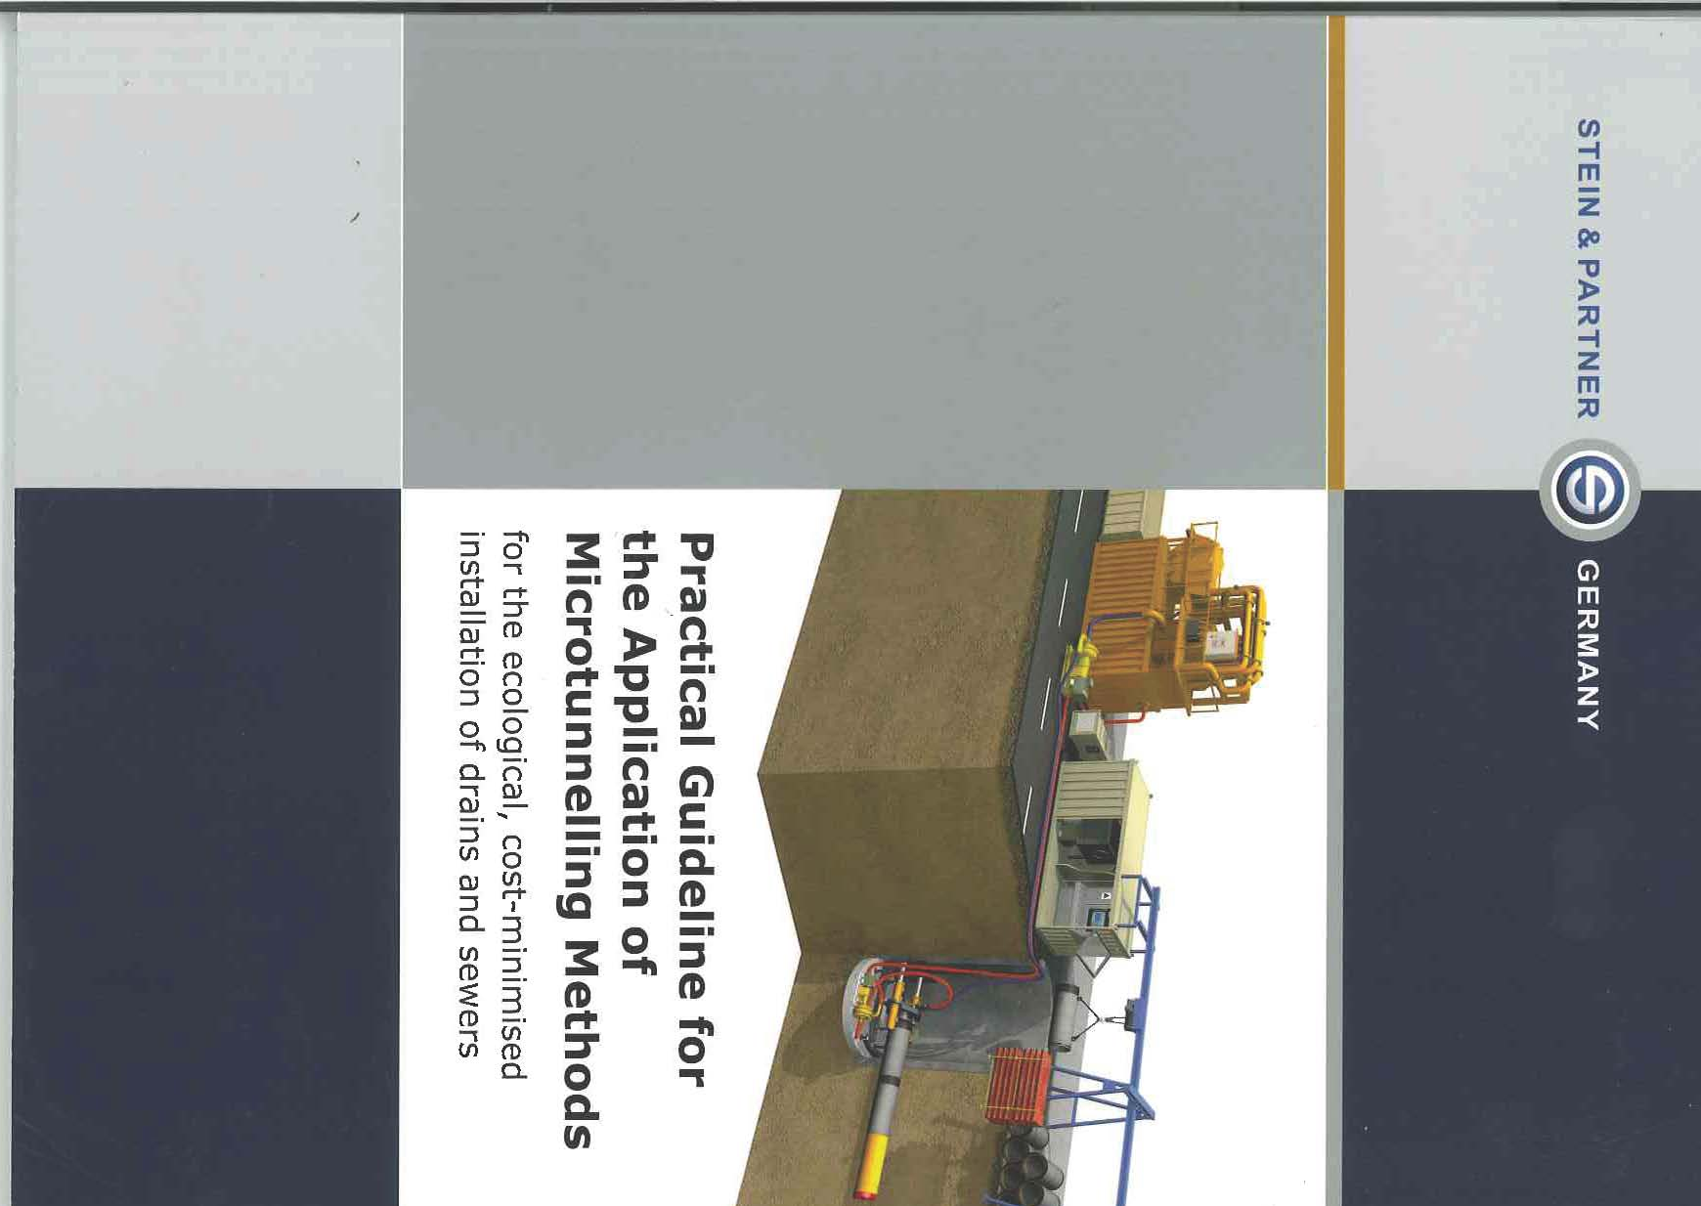
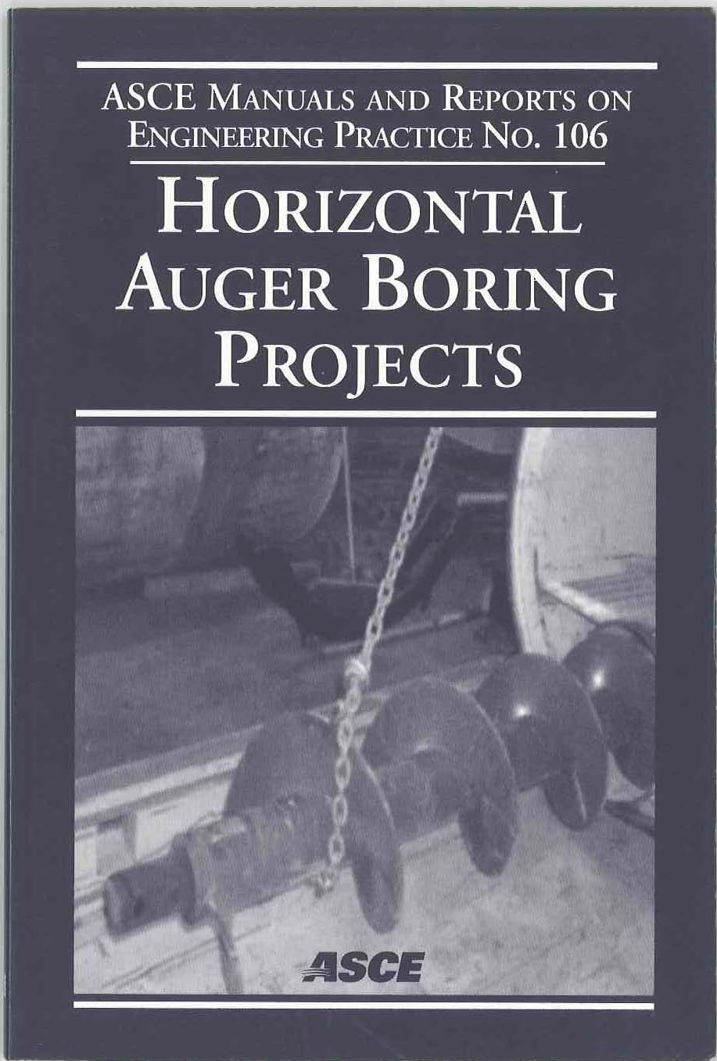

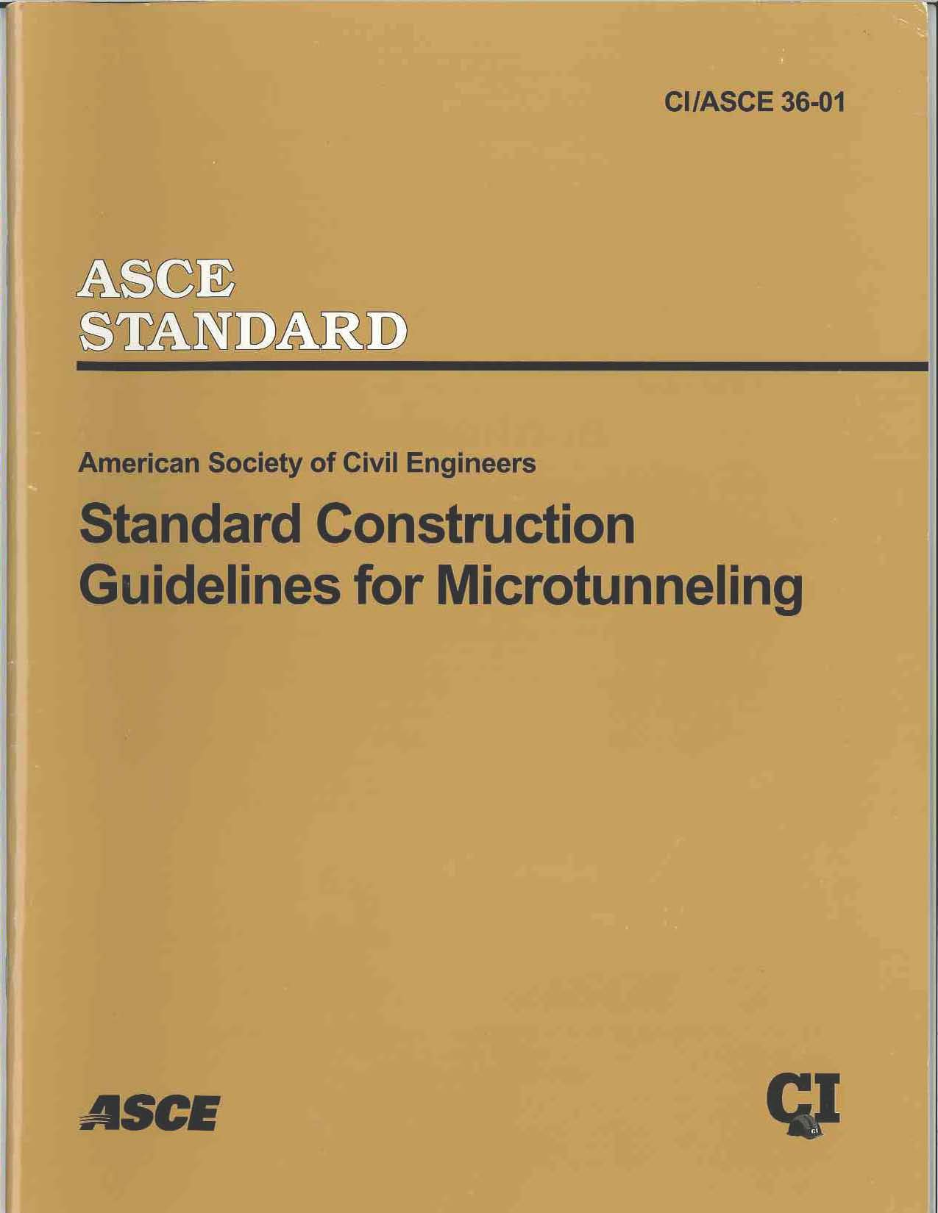

Slide 8
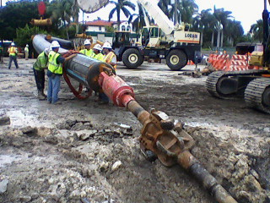
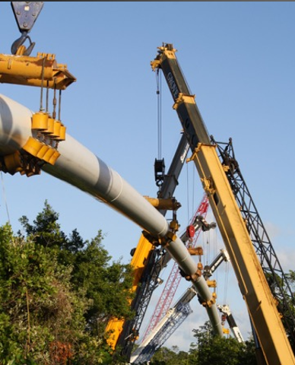
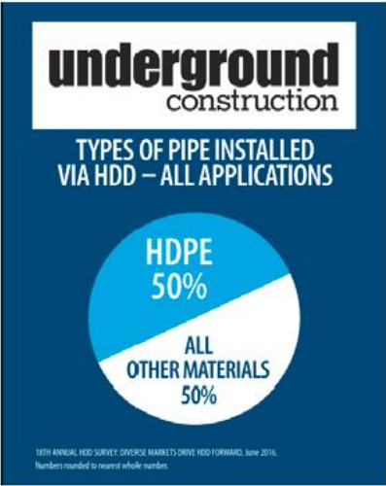
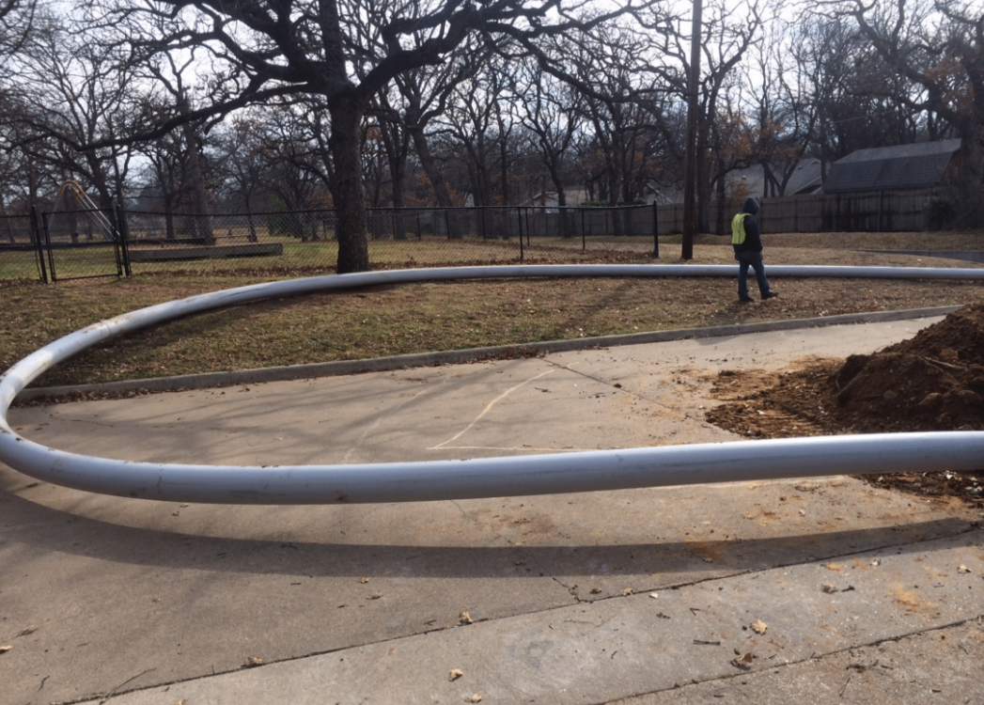
Why HDPE?

Slide 9
Why HDPE?
HDPE allows tightest curves
Lighter and easier to handle during pullback
Most ductile material
Not susceptible to long running cracks or fractures
Incredibly tough material
Lowest frictional resistance of any common piping material
Lower weight / ft helps reduce pull back forces
Scratch/gouge resistant
Impact resistant
Butt fusion strength
Longest design life

Slide 10
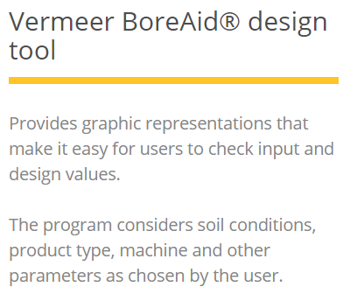
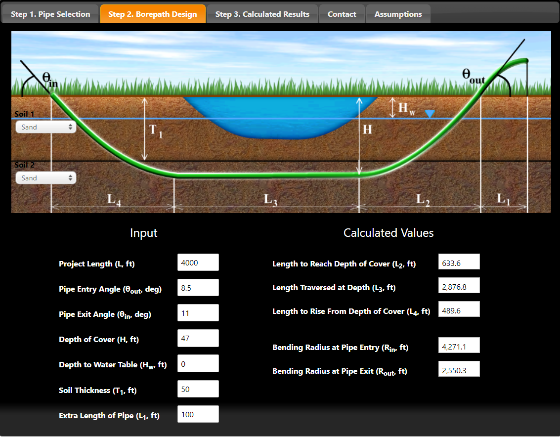

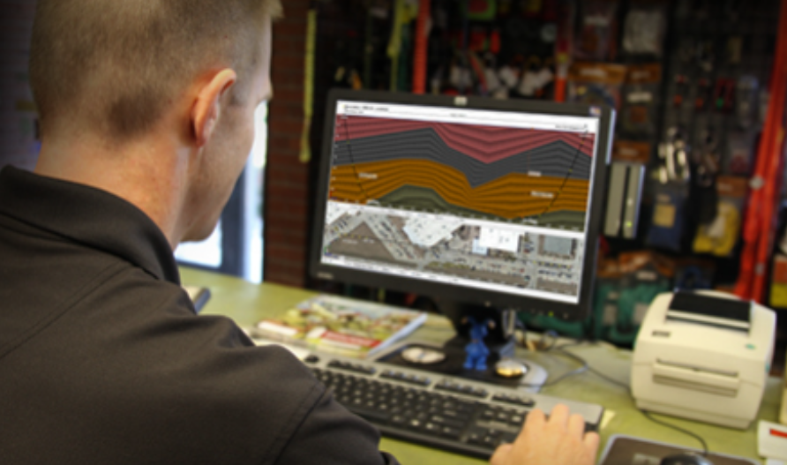
Vermeer offers Full Version for Commercial Use

Slide 11
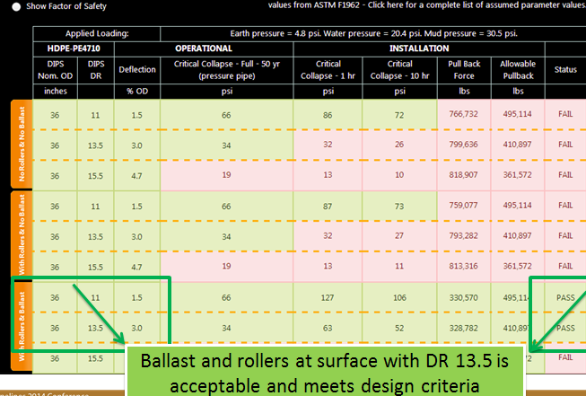
PPI BoreAid (free; non-commercial)
No Rollers
No Ballast
With Rollers
No Ballast
With Rollers
With Ballast

Slide 12
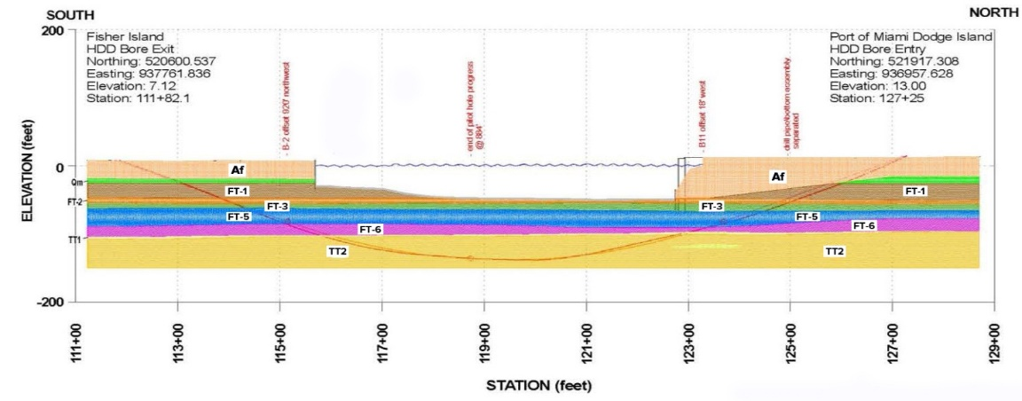
Things That Drastically Influence Bore – Risk Mitigation
How is pipe managed during pullback on ground surface
  Continuous run, segmented lengths, pulled on surface, with rollers, floated (???)
Entry pit and receiving pit constraints / right of way, work space
Profile of bore
Down hole bore stability and earthen loads – mud mix design and selection
Unconstrained buckle from drilling fluids or ground water table
Buoyancy control of pipe string & using hydraulic ballasting during pullback
Underlying stratigraphy and local geology – obtain geotechnical drill logs

Slide 14
Things That Drastically Influence Bore – Risk Mitigation
Require thorough survey by qualified geotechnical engineers or geologists familiar and experienced with HDD
Get input from HDD contracting experts “up-front”
Do not “over specify”. Give latitude to manage drilling mud and operation of drill at job site.
Require contractors to demonstrate a record of experience in size range and soil type of proposed HDD.
Focus on a performance specification
Consider job-site monitoring
  Mud pressure
  Mud flow-rate
  Mud containment
  Mud disposal
  Pipe progression
  Sounding devices
Require a mitigation or contingency plan in case of frac-out (fluid pressure exceeds cohesive strength)
Use rollers or other methods to reduce friction during pullback operations
Consider flooding pipe to counter buoyancy and reduce friction with ceiling of opened bore hole

Slide 15
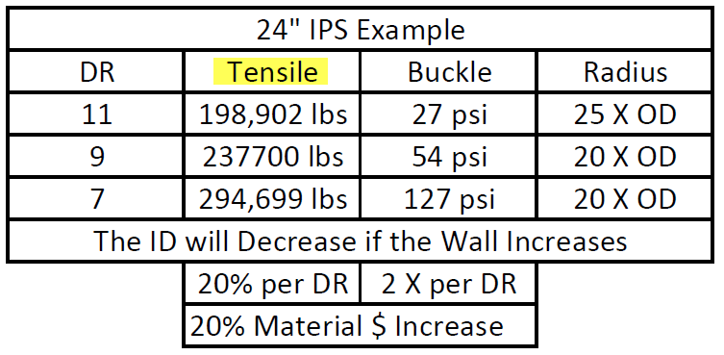
Things That Drastically Influence Bore – Risk Mitigation
DR Selection
Mud Mix
Tooling
Rig Capabilities
Changing by 1 DR to a thicker wall pipe is
Very Cheap Insurance

Slide 16
Summary
HDPE has been used successfully for decades in HDD applications
Industry standards and guidelines are readily available for assistance when considering installation loads when directional drilling with HDPE
Industry standards and guidelines are readily available for assistance on operational loads that will be present in the life of the piping system
Butt fused HDPE provides a very secure and leak free piping system
Allowable bending radius normally tighter than drill equipment
Highly resistant to Rapid Crack Propagation
Highly resistant to cyclical fatigue

Slide 17
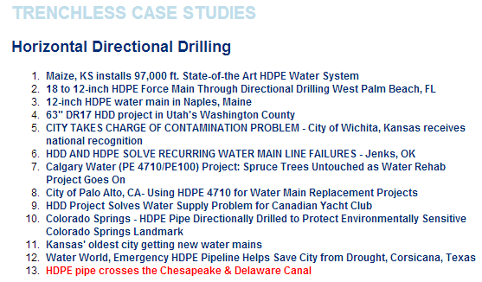
Case Studies

Slide 18
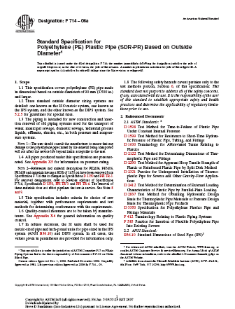
References ASTM Standards
D3350, Standard Specification for Polyethylene Plastics Pipe and Fittings Materials
F714, Standard Specification for Polyethylene (PE) Plastic Pipe (SDR‑PR) Based on Outside Diameter
D2321, Standard Practice for Underground Installation of Thermoplastic Piping
D3261, Standard Specification for Butt Heat Fusion Polyethylene (PE) Plastics Fittings for Polyethylene (PE) Pipe and Tubing
F2620, Standard Practice for Heat Fusion Joining of Polyethylene Pipe and Fittings
F2206, Standard Practice for Fabricated Fittings of Butt-Fused Polyethylene (PE) Plastic Pipe, Fittings, Sheet Stock, Plate Stock or Block Stock
F1055, Standard Specification for Electrofusion Type Polyethylene Fitting for Outside Diameter Controlled Polyethylene Pipe and Tubing
F1290, Standard Practice for Electrofusion Joining Polyethylene (PE) Pipe and Fittings
F2160, Standard Practice for Field Leak Testing of Polyethylene (PE) Pressure Piping Systems Using Hydrostatic Pressure

Slide 19
Horizontal Directional Drilling

